Slide 1
Predicting Influencers in a Social Network
Group 11
Akshay Mehra
Sayam Ganguly
Patrick Green

Slide 2
Objective
Problem Definition
Predict the human judgement about which of two users is more influential in a social network, given twitter activity data for the pair. This is a binary classification problem.
Data Set
Numeric features for pairs of users (A and B). Both training and test data sets provided.
Follower/Following Count
Mentions Sent/Received
Retweets Sent/Received
Post Count
Listed Count (count of inclusion in user-created categories or lists)
Network Features (proprietary calculated features)

Slide 3
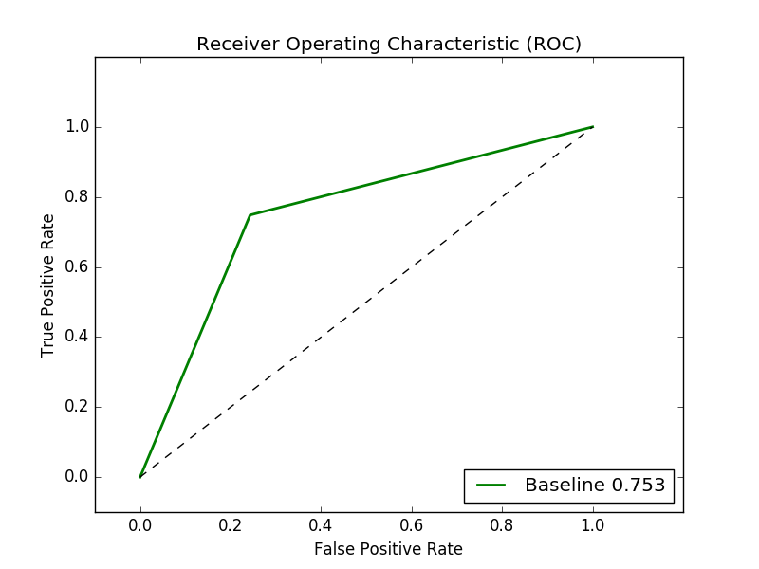
Approach
Pre-processing
Feature Selection – determine which features correlate with influence
Feature Transformations – normalize data
Modeling Methods
Logistic Regression
Neural Network
Support Vector Machines (SVM)
Ensemble
Evaluation
Measuring the area under the Receiver Operating Characteristic (ROC) curve, which plots true positives against false positives for probabilistic outcomes for a range of thresholds.
Baseline Solution
The person who has more followers is the person who is more influential. (Area Under Curve : 0.75175)

Slide 4
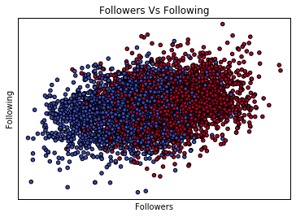
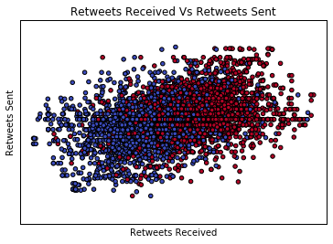
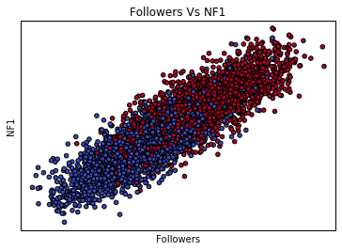
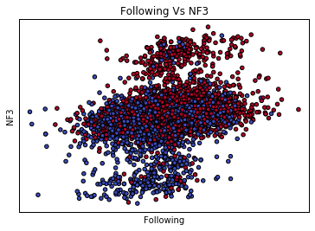
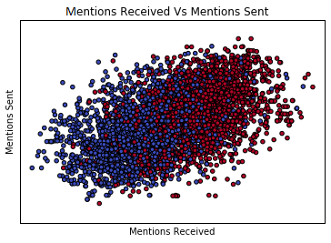
Data Visualization
Plotting pairs of features suggests the relative importance of the features by separability of the data. Red points indicate that user A is more influential; Blue that user B is more influential.
Follower count correlates with influence, but not Following count.
Retweets Received is more important than Retweets sent.
Both Follower count and Network Feature 1 are important to influence, suggested by a diagonal separation.
Network Feature 3 drives influence more than Following.
Mentions Received is more than important than Mentions Sent.
All plots use the difference of logs transform: log(A.feature) – log(B.feature)

Slide 5
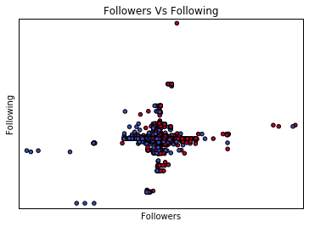
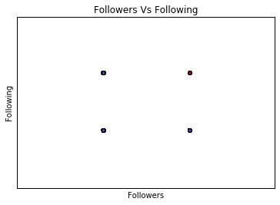
Feature Transformation
Delta Transform
Baseline - absolute difference between values for two users.
Preserves the meaning of large difference in values.
To reduce the scale of the data, we normalize it.
Discrete/Binary Transform
Reduce differences to one (larger for user A) or zero (larger for user B).
Simpler data set, but disregards the magnitude of differences.
Logarithm
Reduces large differences in the orders of magnitude in features (ie. follower versus following counts).
Simplifies non-linear relationships between input and output.

Slide 6
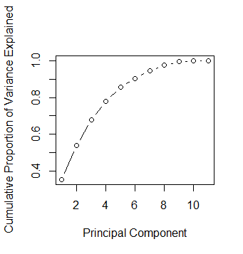
Feature Transformation
Principal Component Analysis
Reduce dimensionality by creating orthogonal components from linear combinations of initial features.
Principal Component 1
A.follower_count – B.follower_count | -0.35497
A.following_count – B.following_count | -0.06158
A.listed_count – B.listed_count | -0.43547
A.mentions_received – B.mentions_received | -0.46721
A.retweets_received – B.retweets_received | -0.46998
A.mentions_sent – B.mentions_sent | -0.05578
A.retweets_sent – B.retweets_sent | -0.07444
A.posts – B.posts | -0.06964
A.network_feature_1 – B.network_feature_1 | -0.47135
A.network_feature_2 – B.network_feature_2 | 0.063936
A.network_feature_3 – B.network_feature_3 | 0.040503
To the left is the composition of the first principal component.
Below is a breakdown of each component.
Principal Components
 | PC1 | PC2 | PC3 | PC4 | PC5 | PC6 | PC7 | PC8 | PC9 | PC10 | PC11
Standard Deviation | 1.9736 | 1.4221 | 1.249 | 1.04245 | 0.9197 | 0.73123 | 0.67873 | 0.57052 | 0.45938 | 0.21665 | 0.10378
Proportion of Variance | 0.3541 | 0.1839 | 0.1418 | 0.09879 | 0.0769 | 0.04861 | 0.04188 | 0.02959 | 0.01918 | 0.00427 | 0.00098
Cumulative Proportion | 0.3541 | 0.538 | 0.6798 | 0.77859 | 0.8555 | 0.9041 | 0.94598 | 0.97557 | 0.99475 | 0.99902 | 1
Can reduce dimensionality to six components and capture ~90% of the cumulative variance.

Slide 7
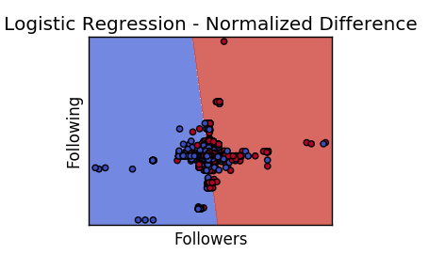
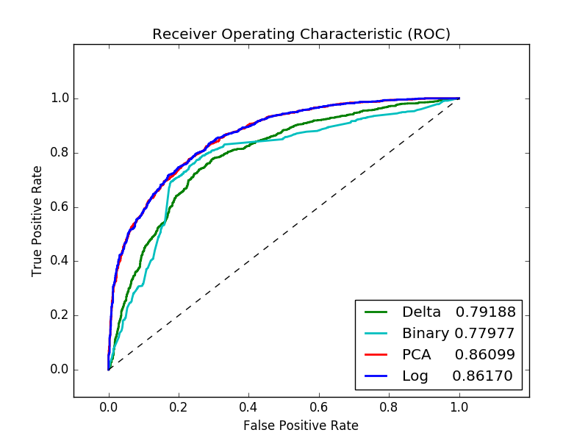
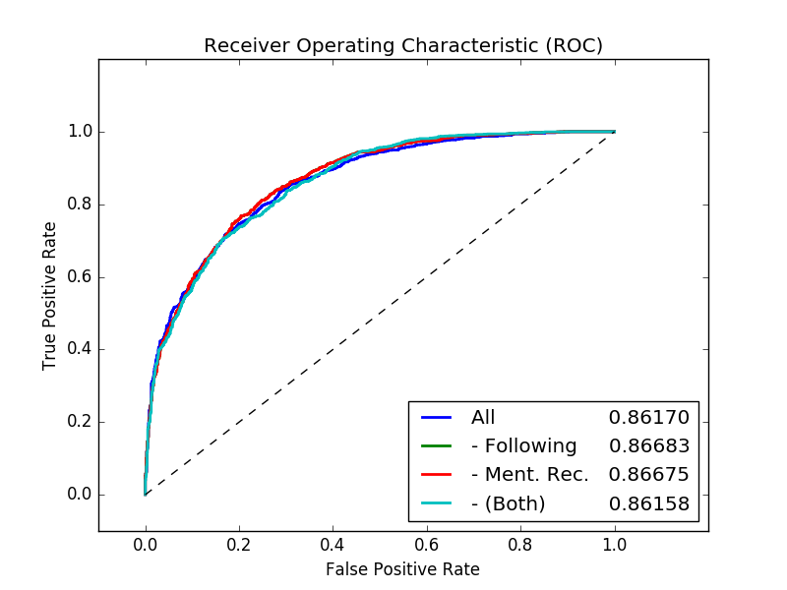
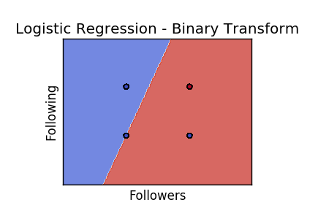
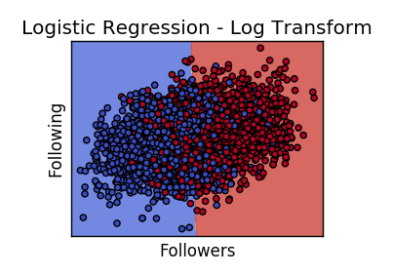
Logistic Regression
The log transform produces the best results, followed closely by the PCA transform.
Removing a single weak feature boosts output slightly, but removing combinations of features tends to negatively impact performance.

Slide 8
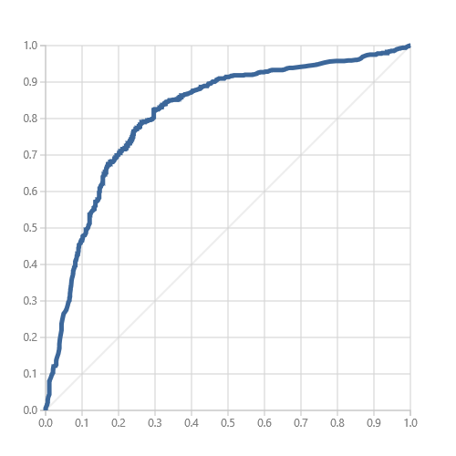
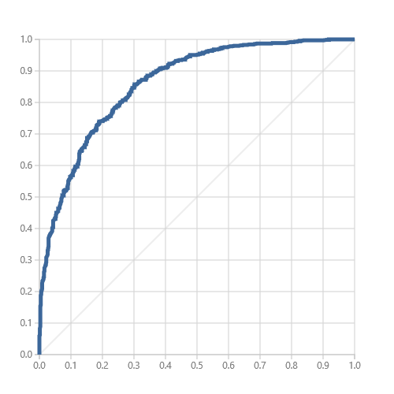
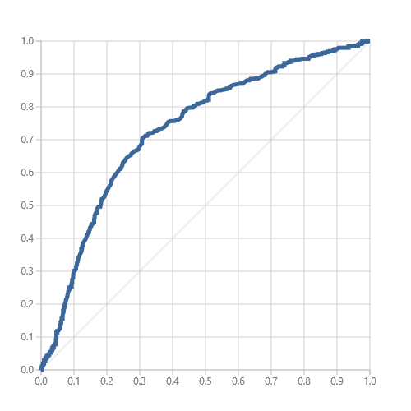
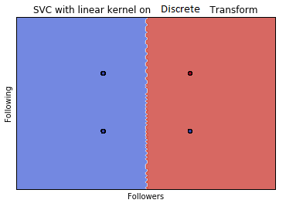
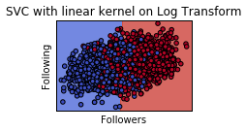
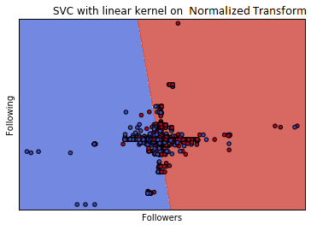
Support Vector Machines (SVM)
The log transform produces the best results, with the delta transform performing poorly.
True Positive Rate
True Positive Rate
True Positive Rate
AUC:0.800586
AUC:0.86057
AUC:0.729937
Test AUC:0.8129
Test AUC:0.85931
Test AUC:0.71758
False Positive Rate
False Positive Rate
False Positive Rate

Slide 9
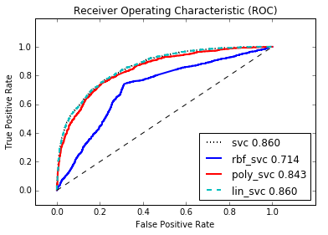
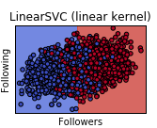
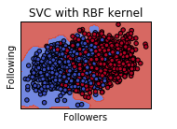
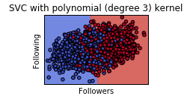
Support Vector Machines (SVM)
The linear SVM model performs best.
All models are using the log feature transform.

Slide 10
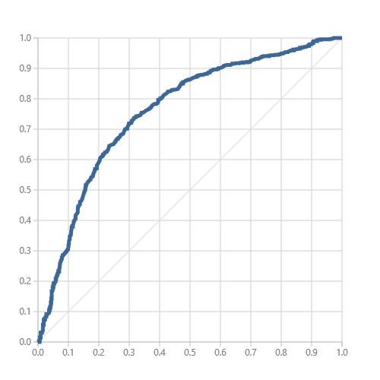
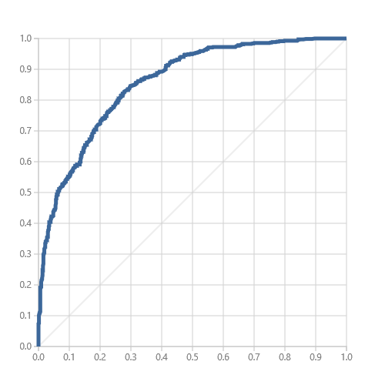
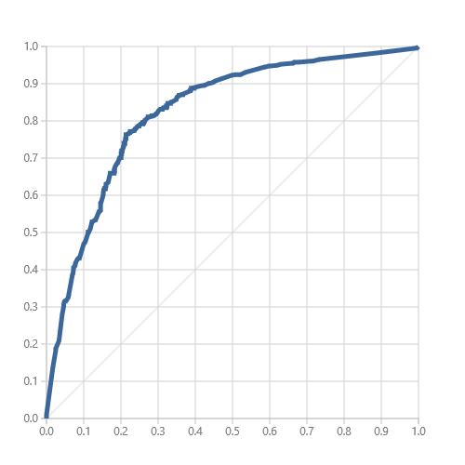
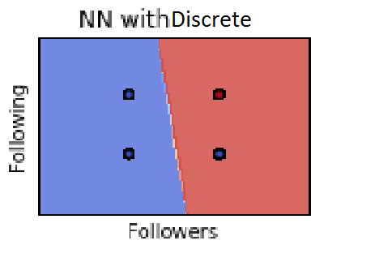
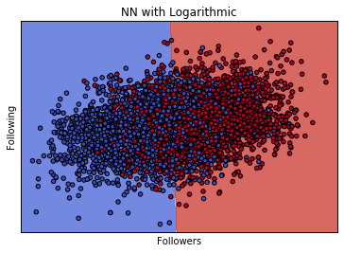
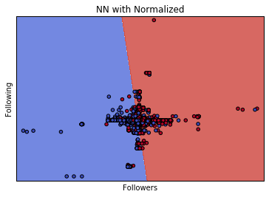
Neural Network (NN)
Again, the log transform produces the best results, with the delta transform performing poorly.
True Positive Rate
True Positive Rate
True Positive Rate
AUC: 0.758
Test AUC: 0.755
AUC: 0.8619
Test AUC: 0.86
AUC: 0.825
Test AUC: 0.83
False Positive Rate
False Positive Rate
False Positive Rate

Slide 11
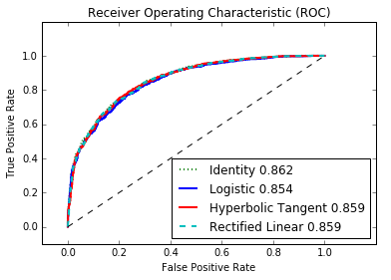
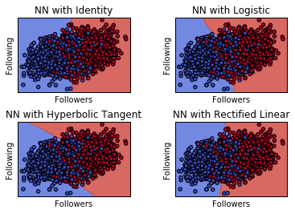
Neural Network (NN)
Neural Network with Identity performs best.
All models are using the log feature transform.

Slide 12
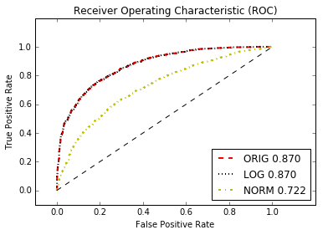
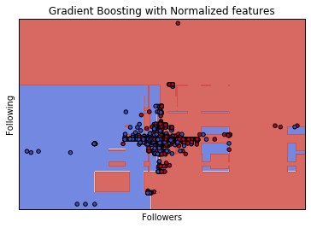
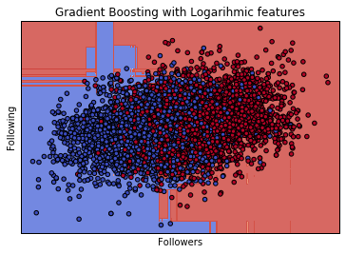
Ensemble Model
Gradient Boosting
A weak decision tree learner is iteratively improved upon using gradient descent to minimize loss.

Slide 13
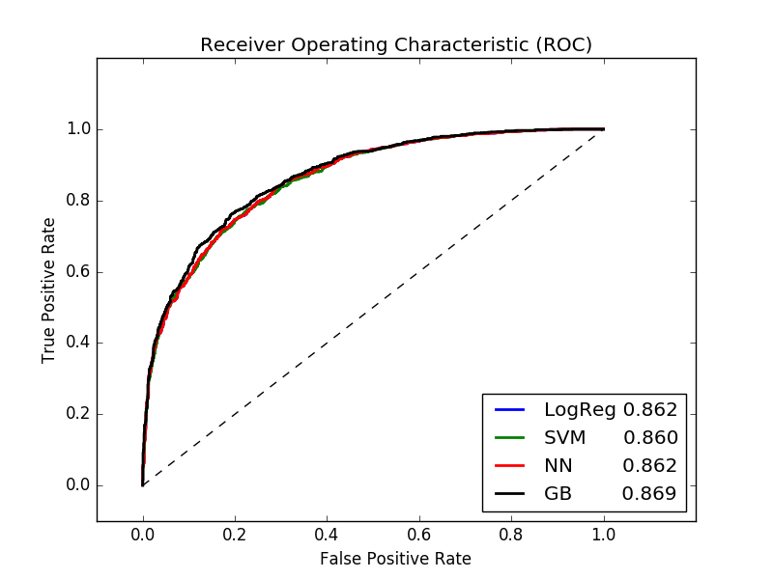
Conclusion
What “Worked”
Ensemble Model with Gradient Boosting - best performing model
Logarithm feature transform
Linear-like separation
What “Didn’t Work”
Discrete/Binary transform
Feature Selection

Slide 14
Thanks!!

